Slide 1



November 2014

Slide 2
Detailed prescription event history – every step of the process!
New search by NHS number, date range and prescription status
www.hscic.gov.uk/eps/tracker

Slide 3
The new tracker provides transparency to both prescribers and dispensers.
Practice and pharmacy can check the current status of a particular prescription and can advise patients with confidence.
The tracker shows the nominated destination of a specific prescription and where a nomination has been changed.

Slide 4
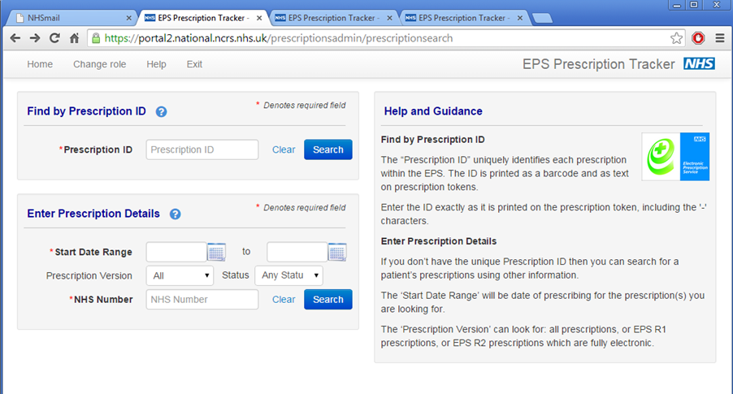
New search by NHS number

Slide 5
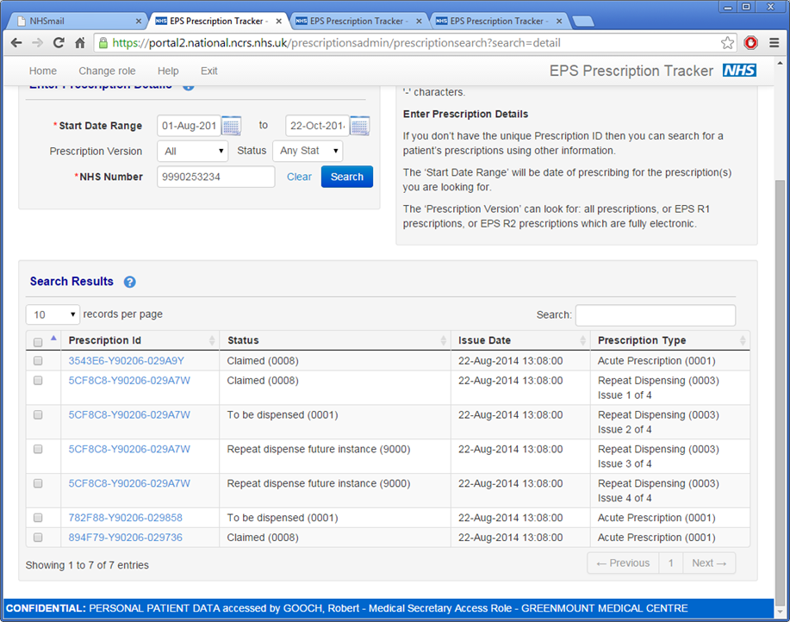
Detailed search results: prescription ID, status, issue date, prescription date i.e. repeat dispensing 1 of 4

Slide 6
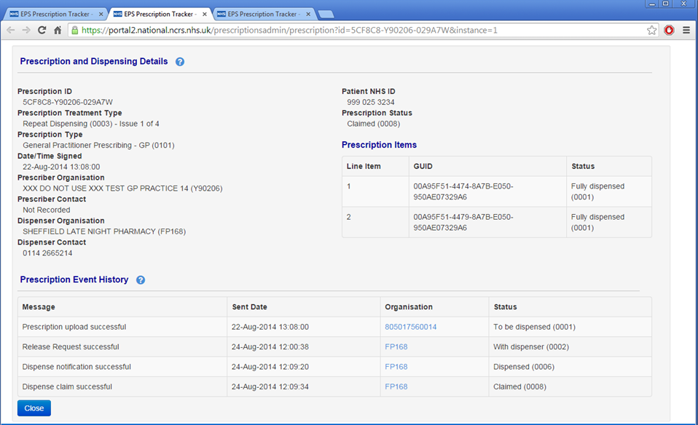
Prescription and dispensing details
and event history…

Slide 7
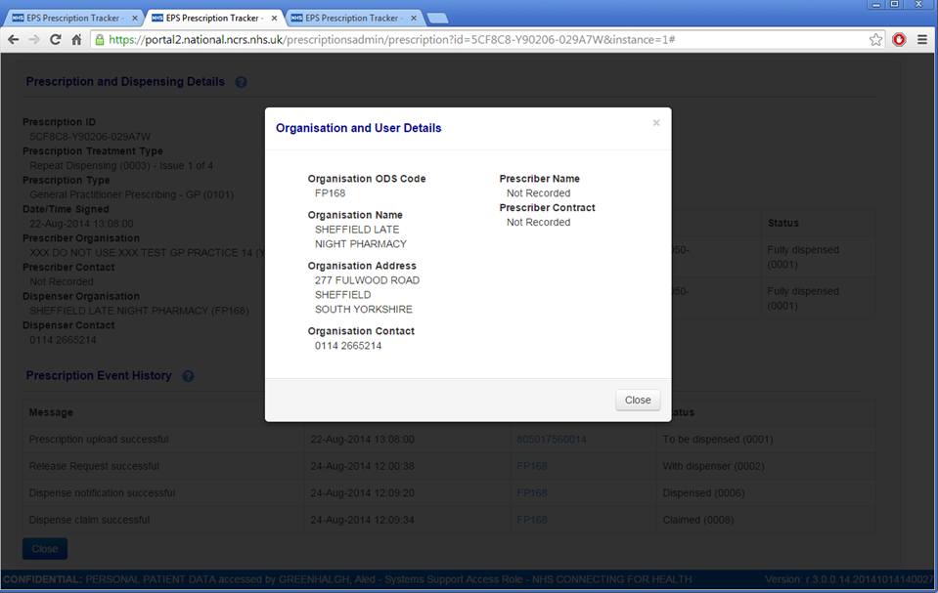
Full contact details

Slide 8
Benefits of the new prescription tracker
Transparency to both prescribers and dispensers.
Practice and pharmacy can check the current status of a prescription and can advise patients with confidence.
Pharmacies can ‘cut and paste’ the prescription number (barcode G.U.I.D) into their dispensing system to retrieve the prescription.
Helps to ensure nomination rules are followed, as it shows the nominated destination of a specific prescription and where a nomination has been changed.
Allows pharmacies to double check that a claim has been submitted - useful for expensive items.

Slide 9

More information
www.hscic.gov.uk/eps/tracker
Contact eps@hscic.gov.uk
@EPSnhs

