Slide 1
Pharmacy first common conditions
Sandie Keall

Slide 2
Agenda
Overview of Common Conditions Service
Checklist and requirements to deliver
Summarise the training on cliniskills
Each condition in brief linked to the clinical pathways
History taking – importance for the assessment process
Practical Assessment
Practice
Recording the Interaction
Summary
Hypertension Case Finding

Slide 3
Overview of the Common Conditions Service
Pharmacy first is a new Advanced service that will include seven new clinical pathways and will replace the Community Pharmacist Consultation Service (CPCS) over time.
The service consists of three elements:
Clinical Pathway consultations
- new element
Urgent supply of repeat meds and appliances
- previously part of CPCS
Referrals for minor illness consultations
- previously part of CPCS
There are no changes to the former CPCS elements of the service, e.g. referrals are still required and telephone consultations are still possible, where clinically appropriate

Slide 4
What is essential in order for pharmacy to be able to deliver?
Standard GPhC Consultation Room requirements and CPAF must be up to date
Read the service specification, clinical pathways, draft Patient Group Directions and protocol as well as the FAQs on the Community Pharmacy England website (cpe.org.uk/pharmacyfirst).
Complete the Manage Your Service (MYS) portal declaration.
Deadline for making this declaration is 11.59pm on 30th January 2024
Develop a Standard Operating Procedure (SOP) for the service.
Start to consider which IT system you will select and contract with to make your clinical records for the service.
Make a training plan with the pharmacists who will be providing the service to ensure that when the service starts
Brief all staff on the service so they are aware that the pharmacy will start to provide the service in the near future
Obtain relevant equipment
Notes:
1. Read the service specification, clinical pathways, draft Patient Group Directions and protocol as well as the FAQs on the Community Pharmacy England website (cpe.org.uk/pharmacyfirst) so that you understand the service requirements. 2. Complete the Manage Your Service (MYS) portal declaration to declare that you agree to the terms and scope of the three elements of the pharmacy First service (NHS Referrals for Minor Illness, Urgent Medicine Supply and the Clinical Pathway Consultations), with approval from head office, if that is applicable. The deadline for making this declaration is 11.59pm on 30th January 2024; however if you register by 11.59pm on 31st December 2023 you will receive the payment on 1st February 2024 (if you register after this date but by 11.59pm on 30th January 2024, you will receive the payment on 1st March 2024 instead)
Start to develop a Standard Operating Procedure (SOP) for the service. When developing or updating your CPCS SOP, include the process for escalation of any clinical and non-clinical issues identified. The pharmacy must have available, signposting details, details for changing the pharmacy’s DoS profile, contact details for local out of hours and urgent care providers and contact details of the local commissioner of the service. 5. If you haven’t already got one, place an order for an otoscope (this does not apply to distance selling pharmacies (DSPs)). Guidance on selecting a suitable otoscope can be found in Annex C of the service specification. 6. Start to consider which IT system you will select and contract with to make your clinical records for the service. Information on IT systems that will be available to support the service is available at cpe.org.uk/pharmacyfirst. 7. Start to make a training plan with the pharmacists who will be providing the service to ensure that when the service starts, they are competent to provide the service including the use of an otoscope (except for DSPs) and be familiar with the clinical pathways, clinical protocol and PGDs. 8. Brief all staff on the service so they are aware that the pharmacy will start to provide the service in the near future; consider using our summary briefing to assist with this

Slide 5
Overview of the service
Pharmacies opting-in must provide all three elements of the new service
Patients can present to the pharmacy for clinical pathways consultations only
Clinical pathways consultations can be provided remotely, except for the acute otitis media pathway (otoscope required)
Remote consultations must be via high-quality video link
DSPs can only provide clinical pathways consultations remotely (due to the link to essential services)
The cannot provide the acute otitis media pathway (otoscope required)

Slide 6
Overview of the service
Referral
Patient presents to the pharmacy
Gateway
met
Urgent repeat meds referral
Minor illness referral
Clinical pathway referral
Gateway
met
Gateway
not met
Gateway
not met
Urgent repeat meds consultation
Minor illness consultation
Clinical pathway consultation
Self-care Essential service
A more detailed service pathway diagram can be found in Annex A of the service spec

Slide 7
Learning Objectives covered in the online course
Describe the key factors to cover when taking a comprehensive clinical history and why.
To know how to take a full structured medical history including a review of systems.
Discuss the tools and techniques that can be used to guide and inform the history taking process.
Use evidence-based practice and relevant guidance to support clinical reasoning and to engage the person in shared decision-making.
Know how to conduct basic observations and clinical examination/assessment skills.
Interpret clinical assessment test results and findings to aid clinical diagnosis and decisions.
Identify presenting red flags in the consultation to enable safe, effective, clinical transfer.
Describe how to close the consultation including follow-up, safety netting, signposting,
and referral when necessary.
9. Know how to complete an accurate and concise record to collaborative
and coordinated care and transfer of care.

Slide 8
Initial quiz
What are the six key parameters of physical assessment?
Why are red flags important?
What is safety netting?
What are the 5Cs of good record keeping?
Why is confidentiality important?
What is consent?
Why is share decision making important?
What is the most important tool in any assessment?
What is the target blood pressure for an adult under 80 years old?
What is the target resting pulse rate for an adult?
What is an expected oxygen saturation rate for an adult with COPD?
What does ACVPU stand for? What does it measure?
Notes:
Answers: BP, HR, RR, Conscious level, Oxygen saturation, temperature
5Cs: Clarity, Consciseness, Contemperaneous, Completeness, Confidentiality
11. 88-92
ACVPU – Alert, Confusion, Responding to voice, Response to pain, Unresponsive or unconscious

Slide 9
News2 scoring

Slide 10
SOCrates

Slide 11
What are the seven conditions?
Sinusitis Sore Throat Acute otitis media Infected insect bite
12 years and over 5 years and over 1 to 17 years 1 year and over
Impetigo Shingles Uncomplicated UTI
1 year and over 18 years and over Women 16 to 64 years
https://cpe.org.uk/national-pharmacy-services/advanced-services/pharmacy-first-service/pharmacy-first-clinical-pathways-resources/

Slide 12
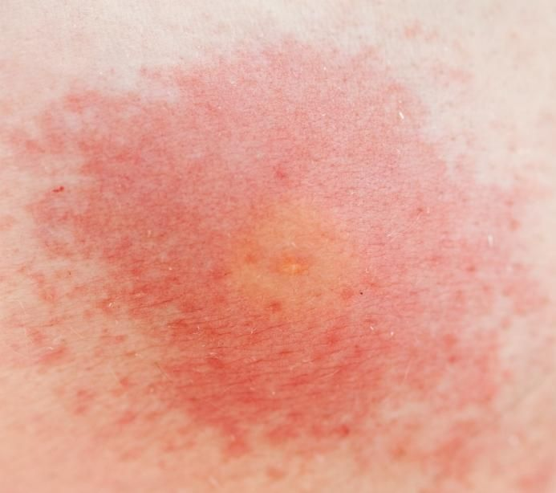
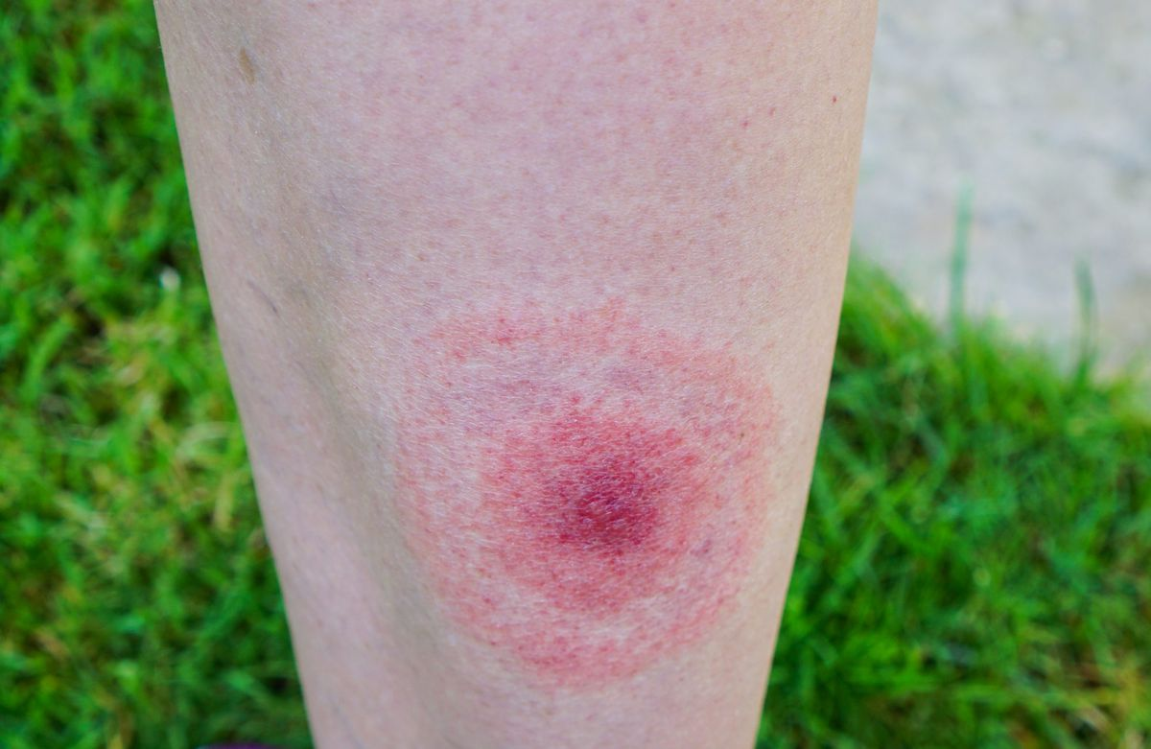
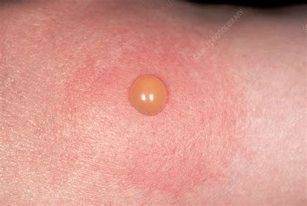
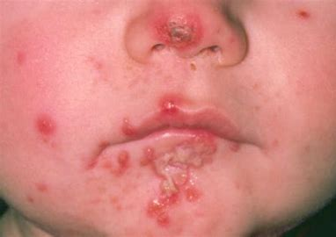
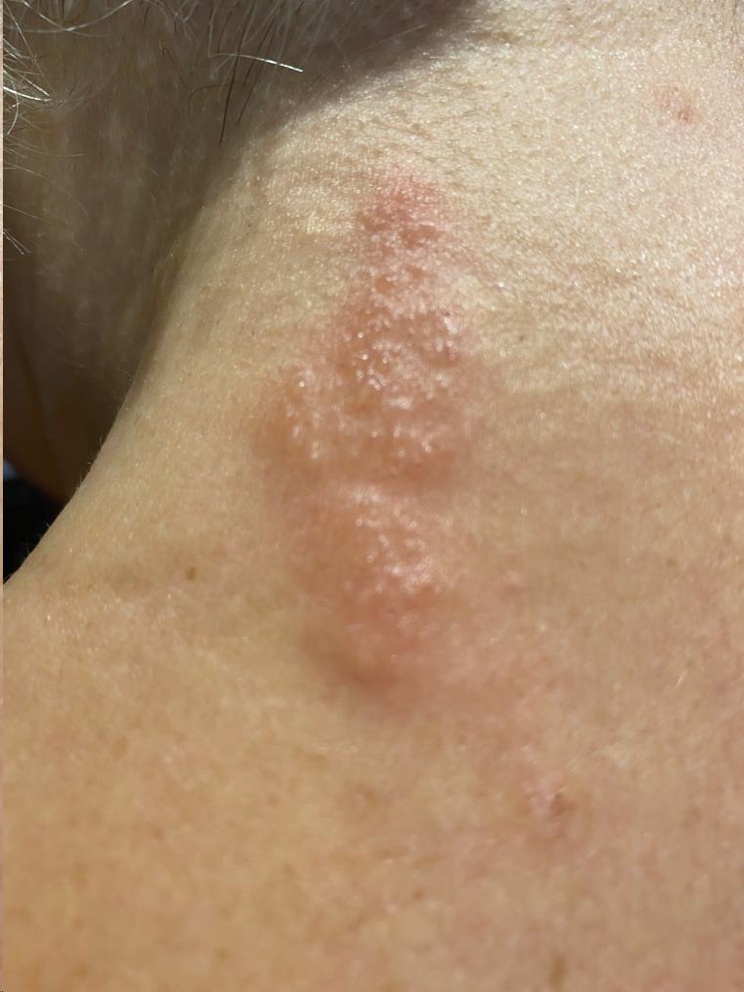
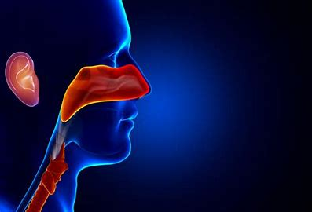
The seven conditions
SKIN CONDITIONS
Infected Insect Bite
Can look like a bullseye, blister or tracking raised mark
Impetigo
Shingles
URINARY TRACT CONDITION
Uncomplicated UTI
Does the patient have any of the 3 key diagnostic signs/symptoms
☐ Dysuria (burning pain when passing urine) ☐ New nocturia (needing to pass urine in the night)
☐ Urine cloudy to the naked eye (visual inspection by pharmacist if practicable)
EAR NOSE AND THROAT CONDITIONS
Sinusitis
Sore Throat
Acute Otitis Media
Notes:
Impetigo
Impetigo is a skin infection that's very contagious but not usually serious. It often gets better in 7 to 10 days if you get treatment. Anyone can get it, but it's very common in young children.
The patches can:
look a bit like cornflakes stuck to your skin
get bigger
spread to other parts of your body
be itchy
sometimes be painful
It stops being contagious:
48 hours after you start using hydrogen peroxide cream or antibiotics prescribed by your GP
when the patches dry out and crust over (if you do not get treatment)
Are there other urinary symptoms: ☐ Urgency ☐ Frequency ☐ Visible haematuria ☐ Suprapubic pain/tenderness

Slide 13
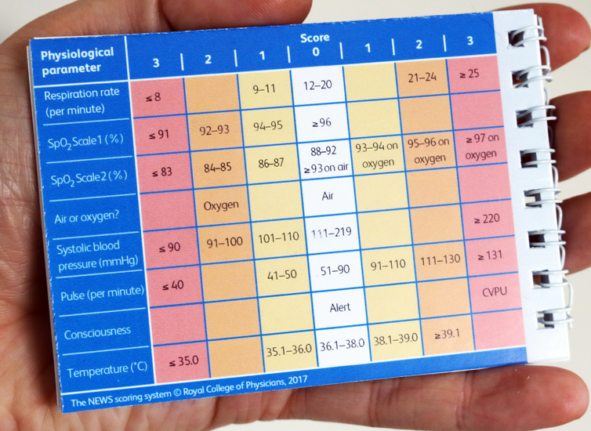
Gateway points
Within each of the pathways there is a gateway point which must be reached before a Common Conditions consultation is processed.
This includes:
That the patient identified is within the inclusion criteria
Are there any exclusions to accessing the service
Does the patient present any red flags needing immediate referral
Has the patient presented with the identified clinical symptoms to access the service

Slide 14
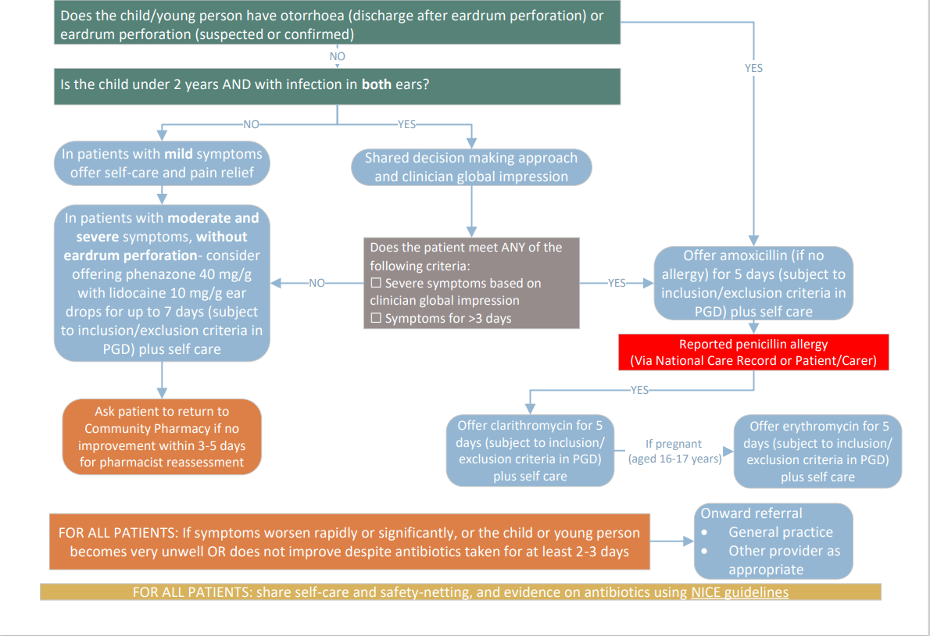
Clinical pathways

Slide 15
Treatment options via pgd for the seven common conditions
Community Pharmacy Counselling Checklist V3.pdf (rcgp.org.uk)
Community pharmacy flowchart V1 DOC.docx (live.com)

Slide 16
Calgary Cambridge Model of Consultation

Slide 17
Consultation skills – initiate the session
Introduce yourself
Explain about confidentiality and gain consent to proceed
Gain consent to access and share medical information
Explain that you will carry out an assessment and if appropriate you may be able to treat
Explain that if appropriate you may need to refer to another healthcare professional

Slide 18
Consultation skills – gathering information
Chief complaint: Ear? Nose? Throat? Neck?
History of Present Illness:
Onset, frequency, duration
Associated symptoms
What has the patient already tried?
Pertinent positives & negatives
Always think: “Could this be related to something more serious?”
Previous work-up, testing, imaging, or interventions
What has already been done or tried for this?
Past Medical History:
Allergies? Asthma? Neurologic or rheumatologic disorders?
Past Surgical History: Head and neck procedures?
Allergies- Aspirin Sensitivity?
Medication - Is this problem medication-related?
Social History - Smoker? Alcohol use?
Family History- Does this run in the patient’s family?
General: fever/chills/weight changes
Ear: tinnitus/ vertigo/ hearing loss/ otalgia/ otorrhea
Nose: congestion/ rhinorrhea/ epistaxis/ decreased smell
Throat: pain/ dysphagia/ odynophagia
Larynx: hoarseness/ voice changes/ noisy breathing/ difficulty breathing / pain with speaking (odynophonia)
Trachea: noisy or difficulty breathing
Neck: lymphadenopathy/ new lumps or bumps/ pain/ swelling
Face: sinus pain/ pressure/ swelling/ numbness

Slide 19
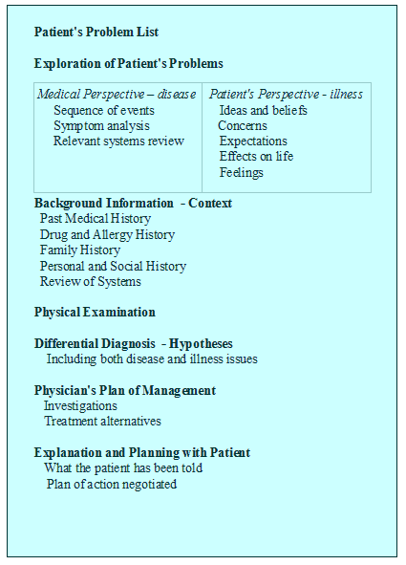
Clinical History Taking

Slide 20
History taking
In threes, one person is the pharmacist, one person is a patient, third person is observing and giving feedback.
Person who is the patient to identify a time when they have had a sore throat, ear infection or an allergy.
Only answer questions asked
If it is a closed question then give a yes/no answer
If it is an open question then take the conversation in whatever direction you see appropriate.

Slide 21
Physical examination
Tips:
Remember that you will be approaching the patient very closely and are examining the head and face so be careful not to invade the patient’s personal space. (Also, check your breath and monitor the volume of your voice accordingly!)
Try to go in the same order each time you examine the patient
Tools:
Pen light, tongue depressor, otoscope, pulse oximeter
Your eyes and hands
First, start by looking at the skin of the face
Look for scars, any concerning lesions
Check for symmetry, is there muscle weakness?
Does the patient have tell-tale signs?
Nasal crease in allergies
Noisy nasal breathing?
Listen to the patient’s voice as they give the history/answer questions
Is it breathy? Nasal? Does the patient have stridor?
Be observant. Most of this can be done within the first few minutes in the exam room
You can also usually get a sense within a few moments if the patient is acutely ill or whether their problem is more chronic in nature

Slide 22
Sinusitis
Consider the risk of deterioration or serious illness
Intraorbital or periorbital complications such as orbital cellulitis, displaced eyeball, reduced vision
Intracranial complications, including swelling over the frontal bone
Signs of meningitis, severe frontal headache, or focal neurological signs
Consider calculating NEWS2 Score ahead of signposting patient to A&E or calling 999 in a life threatening emergency

Slide 23
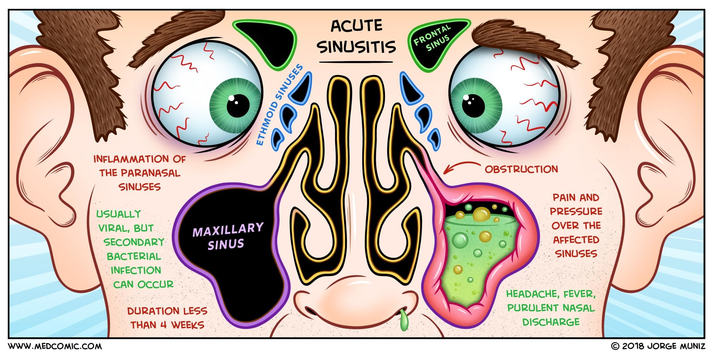
Common Ear, Nose and Throat conditions - sinusitis
Diagnose acute sinusitis by the presence of ONE or more of:
☐ Nasal blockage (obstruction/congestion) or
☐ Nasal discharge (anterior/posterior nasal drip)
With ONE or more of:
☐ Facial pain/pressure (or headache) or
☐ Reduction (or loss) of the sense of smell (in adults)
☐ Cough during the day or at night (in children)
Does the patient have 2 or more of the following
symptoms to suggest acute bacterial sinusitis:
☐ Marked deterioration after an initial milder phase
☐ Fever (>38°C)
☐ Unremitting purulent nasal discharge
☐ Severe localised unilateral pain, particularly pain
over the teeth (toothache) and jaw
Notes:
A high-quality record, therefore, needs to:
be complete, accurate, relevant, accessible, and timely (CARAT – see Annex A)
enable the effective and reliable presentation of patient information from the patient’s records relating not just to the clinical data but other forms of data such as demographics, appointments, administrative, documentation, etc.
allow the data to be arranged in the record to support the purpose for which it is being used. To achieve this there is a complex relationship between how the data is structured, described, and coded (typically using SNOMED CT). It is important to understand the capabilities of the system in order allow data to be entered to support this aspect of record quality. This is critical to research and other secondary purposes
capture information relating to a consultation which can be in the form of highly descriptive narrative content and context, or highly structured clinical data in the form of a clinical vocabulary such as the SNOMED CT
allow the recording and automation of clinical and non-clinical data entry through tools designed to facilitate this such as templates, concepts, protocols etc.
be in a format that allows IT systems across the health and care sector to communicate with each other. (This is beyond the scope of this guidance but organisations such as the Professional Records Standards Body provide standards to improve data quality and interoperability for precisely this purpose. It is important that the data is of the correct format, abides by the standards and is of sufficient quality to facilitate this purpose)

Slide 24
Sore throat
Does the patient have signs or symptoms indicating possible
scarlet fever,
quinsy or
glandular fever? (refer to NICE CKS for list of symptoms)
Does the patient have signs and symptoms of suspected cancer?
Is the patient immunosuppressed?

Slide 25
Common Ear Nose and Throat conditions – sore throat
ASSESSMENT
Will include a physical and holistic assessment
Scoring system to be identified during the assessment
The FeverPAIN criteria: score 1 point for each (maximum score of 5).
Fever (during previous 24 hours).
Purulence (pharyngeal/tonsillar exudate).
Attend rapidly (within 3 days after onset of symptoms).
Severely Inflamed tonsils.
No cough or coryza.
A score of 0 or 1 is associated with a 13-18% likelihood of isolating streptococcus. A score of 2 or 3 is associated with a 34-40% likelihood of isolating streptococcus. A score of 4 or 5 is associated with a 62-65% likelihood of isolating streptococcus.

Slide 26
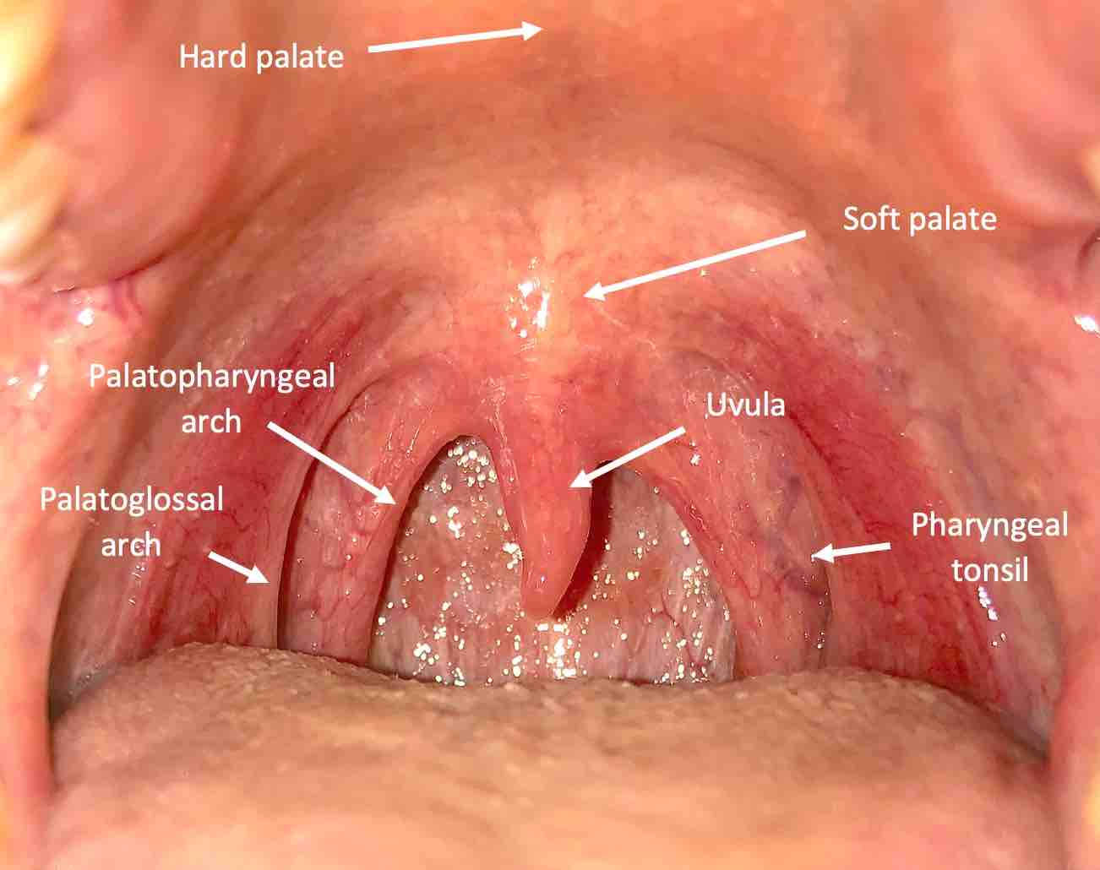
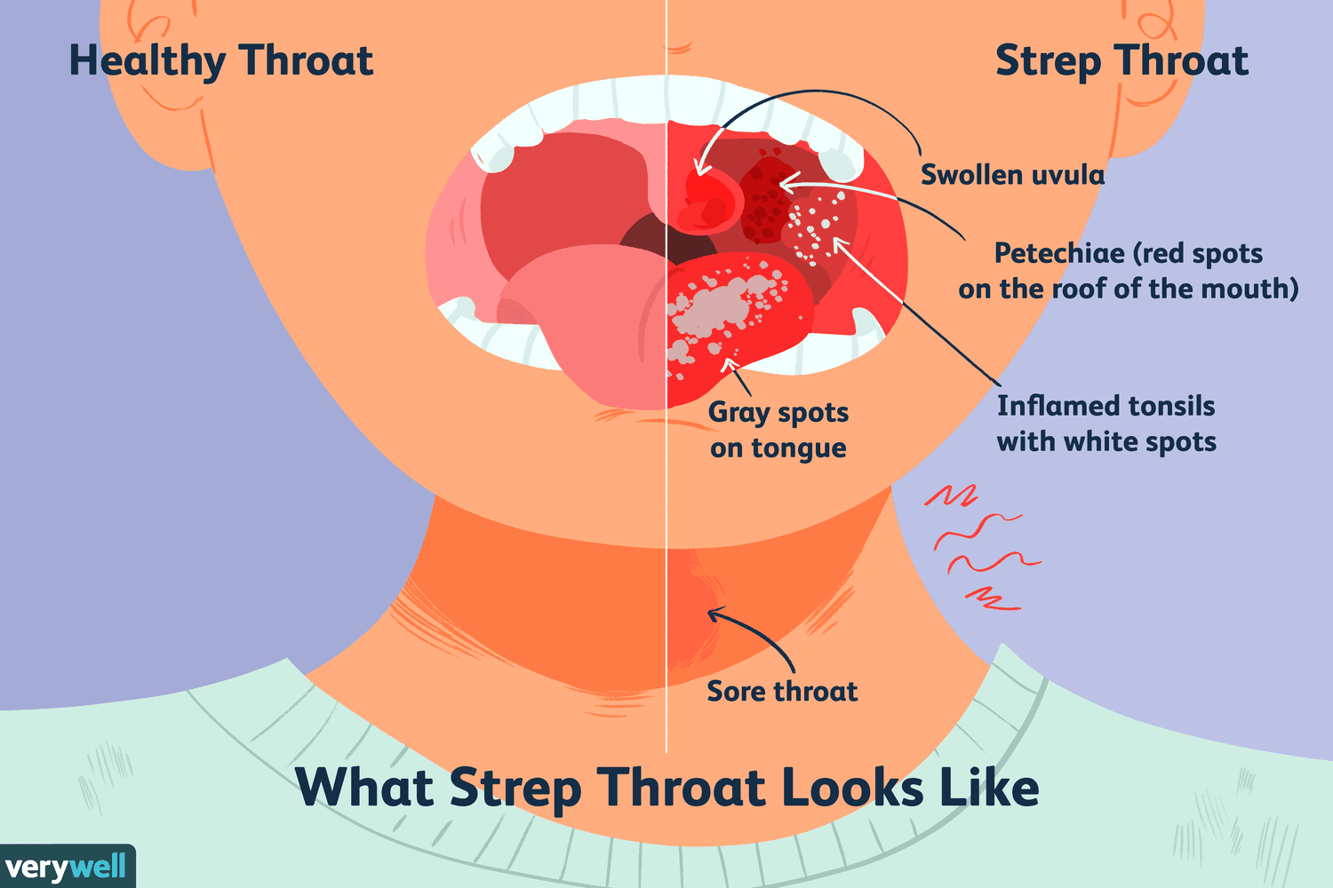
Tongue depressor
Key points:
Use the light on the otoscope to view the mouth to begin the examination
Get patient to open mouth and if necessary slightly protrude the tongue
Insert tongue depressor mid way into the mouth on the tongue
Press down gently
View all aspects of the mouth
If the patient is gagging the likelihood is you have the item too far in the mouth

Slide 27
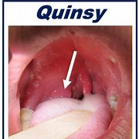
Conditions may include
Globus – feeling of a lump in the throat or something stuck in the throat
Often linked with an emotional response
Can often be helped with lifestyle changes
Often worse if dehydrated
Quinzy – peritonsillar abscess
Infection – if identified can be treated by following the pathway to use PGD

Slide 28
Otitis media
Suspected acute complications:
☐ Meningitis (neck stiffness, photophobia, mottled skin)
☐ Mastoiditis (pain, soreness, swelling, tenderness behind the affected ear(s))
☐ Brain abscess (severe headache, confusion or irritability, muscle weakness)
☐ Sinus thrombosis (headache behind or around the eyes)
☐ Facial nerve paralysis

Slide 29
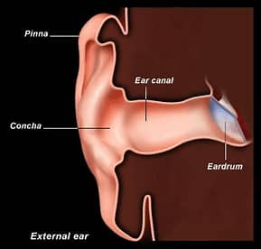
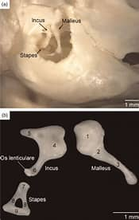
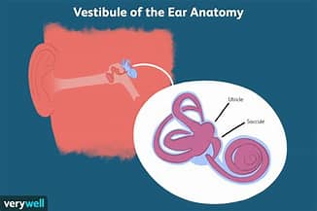
Anatomy of the ear
The outer ear consists of the pinna, the visible part that collects sound waves, and the ear canal, which leads to the eardrum
The inner ear contains the cochlea, a spiral-shaped structure filled with fluid and hair cells that convert sound waves into nerve impulses. The inner ear also contains the vestibular system, which consists of three semicircular canals and two sacs that sense head movement and orientation.
The middle ear contains three tiny bones called ossicles, which amplify and transmit sound vibrations from the eardrum to the inner ear.

Slide 30
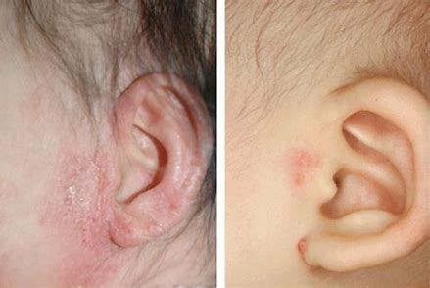
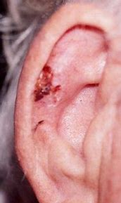
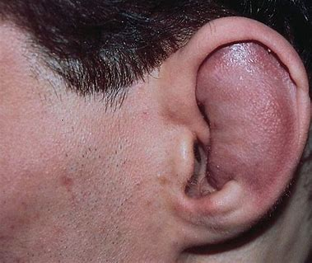
Assessment of the ear
External examination
Are there any deformities, swellings or skin issues
Lesions – acute wounds or intentionally ie piercings
Ulcers
Oedema or swelling

Slide 31
The otoscope

Slide 32
Using an Otoscope

Slide 33
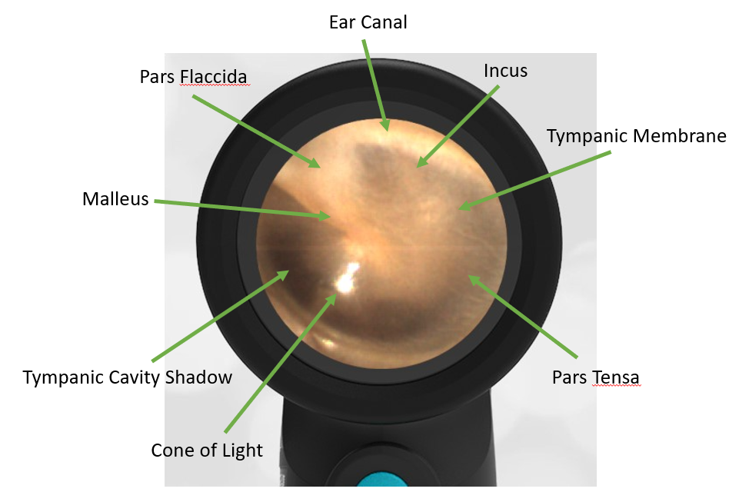
Otoscopy assessment
Otoscopy
Turn on the light – check it is working
Pull the pinna upwards and outwards to straighten and lengthen the ear canal
As you enter the ear look at the walls of the outer canal
is it narrowed,
are there any lesions or flakes of skin,
are there any foreign bodies,
is there any discharge
Any redness
Any wax build up

Slide 34
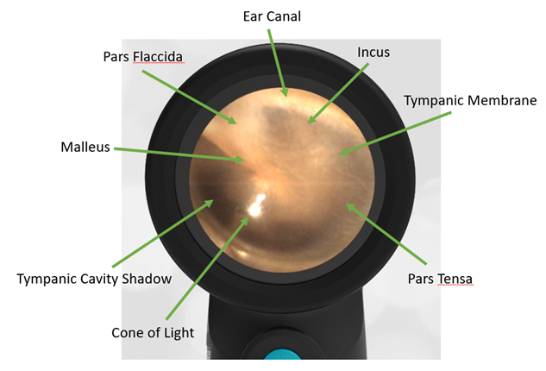
Otoscopic assessment
Tympanic Membrane – ear drum
Normal: Shiny, translucent, visible light reflex
Tympanosclerosis (white)
Perforations
Erythema, bulging Dull, retractions
Notes:
Tympanosclerosis can be caused by trauma, infection or surgery. Can cause hearing loss
Erythema, bulging each drum can indicate infection
Dull, retractions to ear drum can be an indication of allergy or trauma or infection. Can also be seen in eustatian tube disruption like a pressure issue

Slide 35
Assessment practice
In 3s take turns
One person carry out the assessment
One person as the patient
One person observing and giving feedback
Document your assessment and findings

Slide 36
guidance on clinical record keeping
Within any patient record either on pharmoutcomes or your PMR or other digital or written system you must sure they are detailed but concise, legible, contemenporaneous and accurate.
Documentation of clinical activity such as findings, interventions, referrals, reviews, consultations, prescribing, administering, service delivery, decisions, advice and medications.
It is vital that records include accurate and full information. They are admissible in a court of law in any litigation case or in any fitness to practice hearings.
If it is not documented how can you prove it happened.

Slide 37
Recording the assessment
Clinical records must be clear, complete, accurate, up-to-date, and legible.
A high-quality record, therefore, needs to:
be complete, accurate, relevant, accessible, and timely (CARAT – see Annex A)
enable the effective and reliable presentation of patient information from the patient’s records relating not just to the clinical data but other forms of data such as demographics, appointments, administrative, documentation, etc.
allow the data to be arranged in the record to support the purpose for which it is being used. To achieve this there is a complex relationship between how the data is structured, described, and coded (typically using SNOMED CT). It is important to understand the capabilities of the system in order allow data to be entered to support this aspect of record quality. This is critical to research and other secondary purposes
capture information relating to a consultation which can be in the form of highly descriptive narrative content and context, or highly structured clinical data in the form of a clinical vocabulary such as the SNOMED CT
allow the recording and automation of clinical and non-clinical data entry through tools designed to facilitate this such as templates, concepts, protocols etc.
be in a format that allows IT systems across the health and care sector to communicate with each other. (This is beyond the scope of this guidance but organisations such as the Professional Records Standards Body provide standards to improve data quality and interoperability for precisely this purpose. It is important that the data is of the correct format, abides by the standards and is of sufficient quality to facilitate this purpose)

Slide 38
Simple model to ensure recording of information is succinct and accurate
SITUATION
How was the patient referred to you – self referral or from another healthcare organisation?
What did the patient present with?
List the symptoms?
What did the history tell you?
TASK
What assessment did you carry out?
What scoring system did you use if appropriate and what was the score?
What were your findings?
ACTION
What steps did to take to treat in line with the clinical pathway?
What information was the patient given?
What lifestyle and behavioural information was shared with the patient?
RESULT
What follow up actions have been taken or suggested to the patient?
If you could not help the patient or there were red flags, how and who did you contact for further assessment?
Where did you tell them to go if they do not improve?
STAR

Slide 39
Remember
You are not only treating a condition but a person
Have you given advice on lifestyle
Including alcohol, smoking, diet if necessary as all can impact on outcomes
Have you identified and agreed a treatment plan?
Have you identified an appropriate route of action should the condition or symptoms not improve?
Have you given a treatment and obtained the appropriate fee should it be required or identified the exemption and completed the appropriate paperwork?
Documentation is vital and should be completed immediately, if not the patient is at risk should the problem escalate and another health professional needs to act

Slide 40
Target patient leaflet

Slide 41
Summary
Identify the patient – walk in or referral
Do they meet the Gateway for the service?
Any red flags? Ensure the patient has onward referral by you not signposted
Does the patient consent to the consultation and sharing of information?
Gather accurate history and presenting complaint information
Carry out any assessment or clinical investigation as appropriate
Make a decision on appropriate pathway for care, action and medication if necessary is carried out
Ensure the appropriate prescription charges or actions are carried out
Complete accurate and complete records
Ensure the patient has instructions to return or seek help should the condition not improve

