Slide 1
Running a Successful Vaccination Service
Why Relationships Matter - Running a Successful Vaccination Service
Fiona Caplan-Dean

Slide 2

Fiona Caplan-Dean
MRCPharm
35 years experience
Community Pharmacy
Pharma Industry
Pharmacy Services Consultant
Trainer

Slide 3
Agenda
MenB service delivery
Apply the clinical pathway from disease awareness to launch, claims and review
Training & competency
National minimum standards, CPD, disease awareness and risk communication
Clinical governance
SOPs, risk assessment, consultation journey, record keeping and OH arrangements
Disease awareness & urgency
Transmission, symptoms, rash/tumbler test and when to advise urgent care
Eligibility & vaccine history
Year 13 and first-time HERFE entrants, plus prior Bexsero®/Trumenba® scenarios
PGD, resources & Bexsero®
Service specification, Green Book, administration, contraindications and side effects
Launch, promote & fund
Planning, uptake, MYS claims, summary, next steps and action plan

Slide 4
Stakeholder benefits - vaccination services
PHARMACY
PATIENT
NHS
Increased:
  Service income not dependant on NHS for private services
  Footfall – maximising current demographics introducing new demographics
Platform for NHS commissioned services
Enables cost-effective private service expansion
Promoting and positioning as a trusted healthcare provider
Low set up costs
Professional development
Education - increases awareness of health risks
Increased protection
Correct health advice
Convenient hours, location and accessible service
Unrivalled simple customer journey
Trusted brand - Pharmacy
Prevention of diseases that may be transmittable
Increases vaccination rate uptake
Working in collaboration with NHS
Signposting for GP for non-NHS vaccinations

Slide 5
Pharmacy vaccination service strategy
AWARENESS
ACCESS
ADVICE
Increase awareness of
health risks
Encourage patients to seek professional advice before travelling
Improve accessibility and convenience by providing high-quality, clinically robust vaccination services at conveniently located clinics with extended opening hours
Ensure healthcare professionals effectively communicate the benefits of vaccination and health advice to increase patient uptake and protection
Increased footfall, increased loyalty, increased patient protection, increased role as healthcare provider, increased income = increased profit

Slide 6
Considerations when setting up MenB vaccination service
Training
Clinical Governance
Promotion
Ensure you have the correct knowledge and practical skills to provide a service
Support with an efficient operational setup that meets clinical governance guidelines and legal requirements
Strengthen and promote your service once set-up
Disease awareness
Practical
Communicating risk
Process
Staff training
PGDs , IP
Pricing (private)
SOPs/Risk Assessment
Enhanced DBS Check
Internal
In pharmacy
Local
Digital
Social, Google, SEO
Notes:
(NO VGD for this service, so delivery by a Pharmacist or Pharmacy Technician only)

Slide 7







Training
Ensure you have the correct knowledge and practical skills to provide a service
Disease awareness
Practical
Communicating risk

Slide 8
Training
Practitioner Requirements (full details in the PGD)
Before working under a vaccination PGD, practitioners must:
Be authorised to work under the PGD
Complete appropriate PGD and immunisation training
Be competent to work under PGDs (NICE Competency Framework)
Have access to the current PGD and associated guidance/resources
Meet any additional local policy requirements
Be familiar with:
  The vaccine's Summary of Product Characteristics (SmPC)
  The Green Book (Immunisation Against Infectious Disease)
  National and local immunisation programmes
Be competent to:
  Assess patients and administer immunisations
  Discuss vaccination and answer patient questions.
  Store and handle vaccines correctly, including maintaining the cold chain
  Perform intramuscular (IM) and subcutaneous (SC) injections
  Recognise and manage anaphylaxis
Ensure you have the correct knowledge and practical skills to provide a service
Disease awareness
Practical
Communicating risk
Continuing Professional Development (CPD)
  Practitioners must maintain up-to-date knowledge and clinical skills in:
  Immunisation practice
  Recognition and management of anaphylaxis
  Ongoing CPD, with documented evidence of continued competence

Slide 9
Training
Key Requirements for Vaccinators
Vaccinators delivering the service must:
Complete training that meets the requirements of the National Minimum Standards and Core Curriculum for Vaccination Training
Be trained to competently, confidently and safely promote and administer vaccinations
Undertake training in line with the June 2025 updated standards
Pharmacists, pharmacy technicians and any other vaccinators administering the MenB vaccine must have completed practical vaccination training that meets the requirements of the updated national standards
Ensure you have the correct knowledge and practical skills to provide a service
Disease awareness
Practical
Communicating risk

Slide 10
Training
Ensure you have the correct knowledge and practical skills to provide a service
Frequency of training
Pharmacists, pharmacy technicians and other vaccinators should attend periodic refresher training to:
maintain competence
support consistent practice
allows discussion of any clinical issues that are arising in practice
Disease awareness
Practical
Communicating risk
Pharmacy owners and vaccinators will need to consider when it would be appropriate to attend refresher training or if ongoing competence of an individual vaccinator can be evidenced, without the need for face-to-face training

Slide 11
Training
Assessment of vaccinator competency
Vaccinators should maintain a portfolio of evidence, including:
  Competency checklists
  Knowledge test results
  Reflective logs
  E-learning certificates
  Immunisation training and update certificates
This portfolio provides evidence of competence for employers and supports CPD and professional revalidation
Pharmacy owners must ensure vaccinators are competent and retain evidence of competency for all staff providing the service
Competence can be demonstrated through
  The Vaccination Services Declaration of Competence (DoC); or
  The competency assessment tool in Appendix A of the National minimum standards and core curriculum for vaccination training
Ensure you have the correct knowledge and practical skills to provide a service
Disease awareness
Practical
Communicating risk

Slide 12
Clinical Governance
Support with an efficient operational setup that meets clinical governance guidelines and legal requirements
Consultation room set up
SOP & Risk Assessment update
Patient Journey
    Pre, during and post visit
Staff training
    Recruitment of customers
    Service, key messages
PGD provider – NHS, Private
Record keeping
Process
Staff training
Consultation platform – RAVS, Private
Process
PGDs , IP
Pricing (private)
SOPs/Risk Assessment
Notes:
Consultation room set up as previous PLUS check adrenaline amps

Slide 13
Vaccination journey
1
Recruit patient, check eligibility and ask for evidence
Start to complete risk assessment
Information required: Personal details
Medical history Vaccination history
Allergy confirmation
Medical questions
2
The HCP introduces themselves and provides leaflet
Advise the patient of signs and symptoms of the disease, vaccination side effects and further vaccinations
Double checks eligibility - if not eligible offer private service if available
3
HCP completes the risk assessment with the patient and gives verbal and written advice on recommended vaccines, explains Meningitis,
At future appointments - Patient arrives at appointed time and HCP reviews risk assessment again and confirms agreed
If private payment taken if not already taken
4
Patient gives consent for vaccines
If private take payment
5
HCP or trained clinic staff removes vaccine from fridge and HCP completes dispensing double check before preparing vaccine
HCP administers vaccine in accordance with national immunisation guidelines and reiterate potential side effects
Complete risk assessment now
If patient declines, the HCP should document reason why (if given) alongside advised vaccines
6
Provide patient with any additional Patient Information Leaflets for the vaccine administered
Book next appointment, if necessary
REMEMBER TO CLAIM VIA MYS AT MONTH END
Notes:
Customer/ patient journey
Highlights
What team can do, electronic platforms
risk management-Pay first before vaccinate
Dispensing double check
Declining vaccine make a note

Slide 14
Additional training
Understanding the relevant clinical guidance
Vaccinators must read and understand all relevant clinical guidance and keep up to date with any changes
Vaccinators must be able to recognise the signs and symptoms of meningitis and sepsis and communicate these to patients
There is no specific NHS e-learning programme for the MenB vaccination service. Key clinical guidance includes:
  The UKHSA and NHS England bipartite letter
  UKHSA guidance for health professionals delivering the programme
  The UKHSA training slide set
  The service PGD
Ensure you have the correct knowledge and practical skills to provide a service
Disease awareness
Practical
Communicating risk

Slide 15


Promotion
Strengthen and promote your service once setup
External
In pharmacy
Local
Digital
Social, Google, SEO
Top Tip: Register as a pharmacy, not an individual, to order sufficient supplies.
Notes:
Discuss outside to inside
Promo to schools, unis, travel agents, community centres

Slide 16
Promoting your Service

Slide 17
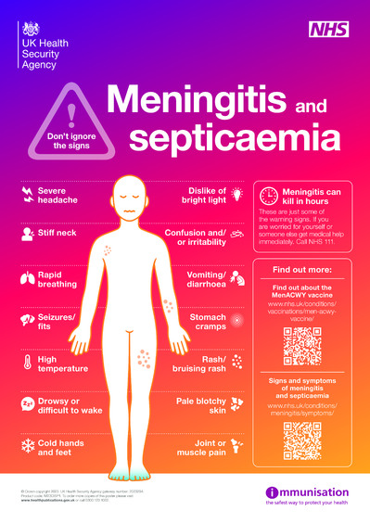


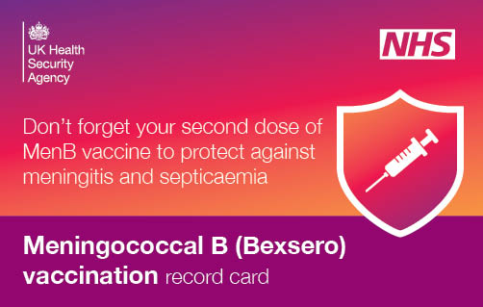
Promotion
Strengthen and promote your service once setup
External
In pharmacy
Local
Digital
Social, Google, SEO
Top Tip: Register as a pharmacy, not an individual, to order sufficient supplies.
A copy of this leaflet may be given to all patients who receive a vaccination

Slide 18
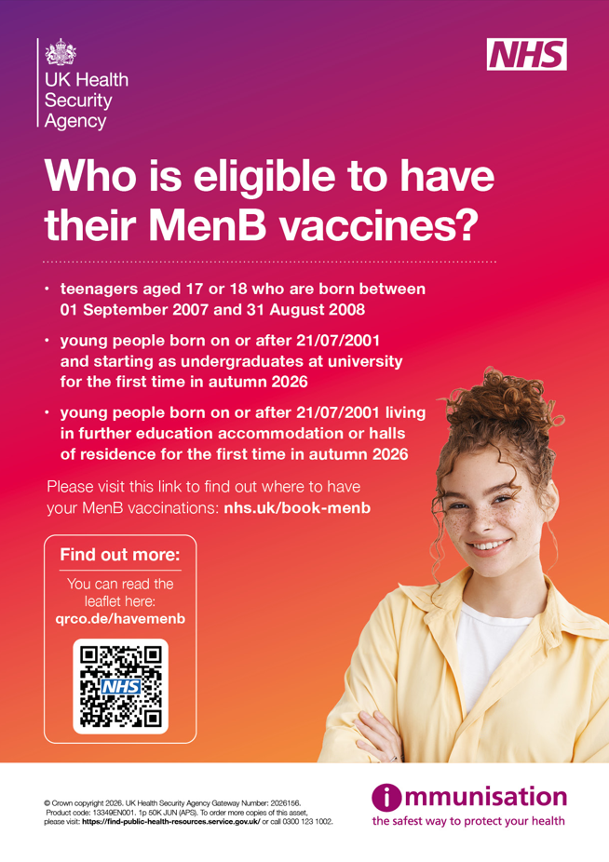
Maximising vaccine uptake
It is important that the MenB vaccine is offered to as many eligible individuals as possible. You can help maximise uptake by:
Displaying posters and digital promotional materials in prominent locations
Making leaflets readily available
Signposting people to reliable online and accessible resources, including Easy Read, British Sign Language (BSL), large print and translated materials
Offering a flexible, accessible service and clearly advertising vaccination times
Providing a suitable environment that promotes privacy, dignity and confidentiality
Ensuring individuals know when to receive their second dose
Speaking positively and confidently about the MenB vaccination programme and encouraging others to do the same

Slide 19
Meningitis Disease

Slide 20
Why MenB vaccination matters
MenB is uncommon, but outcomes can be serious — vaccination protects the individual, not the wider population.
Disease profile
Clinical impact
Vaccination realities
87%
of UK invasive infections are MenB — the most common strain
6%
MenB case fatality; overall meningococcal disease is 5–10%
No herd immunity protects the vaccinated person; it does not stop population carriage
2-dose protection: expected to last about 5 years
Rare
IMD is uncommon (<1 per 100,000/year), but can cause meningitis, septicaemia or both
20–25%
of diagnosed cases have complications
Starts after 14 days: protection develops two weeks after vaccination
Age
18–19
highest rates outside infancy; disease can occur at any age
≈1 in
10
MenB cases have major disabilities, including hearing loss or amputation
Carrier risk remains: MenB can still be carried after vaccination
Kent outbreak- 21 confirmed cases , 2 deaths,7 first year students
Notes:
Kent facts

Slide 21
Transmission, risk and disease onset
Meningococcus is often carried harmlessly, but close-contact spread can lead to fast-moving invasive disease in some people.
Carriage & spread
Who is at higher risk
Timing & urgency
Usually carried harmlessly in the nose and throat of healthy people
Asymptomatic carriage is most common in adolescents and young adults upto 10%
Transmission generally needs frequent or prolonged close contact via saliva or respiratory secretions
Examples include households, coughing/sneezing, kissing, and sharing drinks or vaping devices
Age and season
Smoking
Preceding viral infection
Closed or semi-closed communities, such as university halls of residence
Kent outbreak
  21 confirmed cases
  2 deaths
  7 first year students
Incubation is usually 2–7 days after acquisition
Symptoms may start gradually with mild prodromal illness or begin suddenly
Severe disease can progress rapidly and require urgent treatment within 24 hours of first symptoms
2–7
days typical incubation
24h
possible rapid deterioration
Notes:
Up to 10% are asymptomic carriers

Slide 22
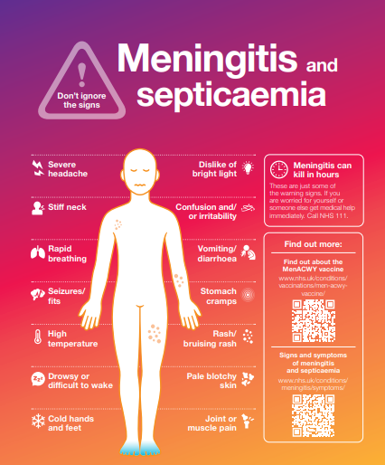
Clinical presentation
Any of these symptoms can arise in any order
high temperature
vomiting
severe headache
feeling unwell
limb/joint/muscle pain
stomach pain/diarrhoea
cold hands and feet
shivering
pale or mottled skin
fast breathing/breathlessness
rash
stiff neck
dislike of bright light
drowsiness/difficult to wake
confusion and/or irritability
seizures/fits
Following vaccination every patient should be advised of the signs and symptoms of meningitis and provided with the leaflet
Notes:
Invasive meningococcal infection most commonly presents as either meningitis or septicaemia, or both
meningitis is inflammation of the lining around the brain and spinal cord (the meninges)
septicaemia occurs when the bacteria enter the bloodstream, causing blood poisoning which triggers sepsis
both meningitis and septicaemia can trigger sepsis
less commonly, individuals may present with pneumonia, myocarditis, endocarditis, pericarditis, arthritis, conjunctivitis, urethritis, pharyngitis and cervicitis

Slide 23
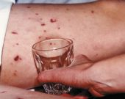
The meningococcal rash
A distinctive red rash can appear anywhere on the body
Formed of tiny ‘pinpricks’ also known as petechiae and appears red or brown in colour
May later develop into purple bruising of the skin
Does not fade when a drinking glass is pressed firmly against it
Febrile illness and rash that does not fade is a sign of meningococcal septicaemia
Absence of a rash does not mean the individual does not have meningitis or meningococcal sepsis – the rash is usually a late sign of sepsis
The ‘tumbler’ test picture courtesy of Meningitis Research Foundation
www.meningitis.org/about-meningitis/symptoms/

Slide 24
Eligibility for the pharmacy service

Slide 25
Consider a private vaccination if a patient isn’t eligible
MenB Vaccine Eligibility Criteria
Eligible for NHS
MenB Vaccine
Is your date of birth between 1
September 2007 and 31 August 2008?
Yes
No
Yes
Are you starting university for the first
time* in Autumn 2026?
Yes
Is your date of birth on or after
21 July 2001?
No
No
Yes
Are you starting at a Further
Education college for the first time* in
Autumn 2026?
Will you be a residential student at one
of these FE settings? List of eligible
residential FE settings?
Yes
No
No
Not eligible for NHS
MenB Vaccine
*including international students, those from Scotland, Wales, Northern Ireland, Channel Islands and Isle of Man

Slide 26
Evidence of Eligibility
Individuals must provide evidence of eligibility
1
Students
Evidence must show:
University/college name
Course title/code
Conditional or unconditional offer
2
Military recruits:
Provide an official joining letter/email or an MOD ID card
First-year university students are at the highest risk of MenB disease.
Risk is approximately 7 times higher in first-year students compared with other university students of the same age.
Opportunity: Those who are not eligible for the NHS Service may be suitable for a private MenB vaccination service

Slide 27
Proof of prior vaccination
What this means
Evidence to check
Some people may already have had first doses, including through outbreak responses, the gonorrhoea vaccination programme or privately.
GP record entries
1
Relevant entries in the GP record confirming prior MenB vaccination.
2
MenB vaccination record card
How to decide
Presentation of a MenB vaccination record card.
Follow the Information for Healthcare Practitioners guidance for the action required at each prior vaccination status.
3
Written or virtual private record
A written or app-based record of dose(s) delivered via a private provider.
Final check: proof of receipt is assessed from clinical records or patient-held evidence before vaccination proceeds.

Slide 28
Incompletely vaccinated or vaccinated more than 5 years ago
Vaccine previously administered
Some individuals may already have received MenB vaccine:
  Privately
  Overseas
  During an outbreak response
  As part of a clinical risk programme
  Through the gonorrhoea vaccination programme
Some may have previously received Trumenba® (Pfizer MenB vaccine).
Individuals may therefore present with a partial or complete previous vaccination course

Slide 29
1/3
Prior Bexsero® vaccination scenario
Scenario
Outcome
Definition / rationale
1 dose Bexsero® (irrespective of timing of that prior dose)
1 dose of Bexsero® now
Where individuals have received one prior dose of Bexsero®, a further dose should be given, a minimum of 28 days after the first dose, to complete the full course of 2 Bexsero® doses.
2 doses of Bexsero® less than 5 years ago
No further doses now
Where individuals have previously completed a two-dose course of Bexsero® within the last 5 years, no further vaccination is required.
2 doses of Bexsero® 5 or more years ago
1 dose Bexsero® now
Where individuals have previously completed a two-dose course of Bexsero® 5 or more years ago then a single dose should be offered.

Slide 30
2/3
Completed Trumenba® course scenarios
Scenario
Outcome
Definition / rationale
2 or 3 doses of Trumenba® (complete course) less than 5 years ago
No further doses now
Where individuals have previously completed a course of Trumenba® within the last 5 years, no further vaccination is required. Two doses at least 6 months apart are considered equivalent to receipt of 3 doses.
2- or 3-dose Trumenba® (complete course) 5 or more years ago
Full, 2-dose course of Bexsero®, starting now
Two doses at least 6 months apart are considered equivalent to receipt of 3 doses. Trumenba® and Bexsero® MenB vaccines are not interchangeable. Where individuals have previously completed a course of Trumenba® 5 or more years ago, they should be offered to restart a two-dose course with Bexsero®.

Slide 31
3/3
Partial Trumenba® course scenario
Scenario
Outcome
1 dose of Trumenba®, or 2 doses delivered less than 6 months apart (partial course)
Start Bexsero® now, 2 doses — or choose to complete the Trumenba® schedule, but not via the national programme
Definition / guidance
Where individuals have had a partial course of Trumenba® (defined as one prior dose, or 2 doses delivered less than 6 months apart), they may complete their vaccination course of that vaccination.
Alternatively, they can be offered a two-dose course of Bexsero®.
There is no specific information on the best interval between Trumenba® and Bexsero®, however from first principles an interval of at least 4 weeks is advised.
Practical interval: at least 4 weeks is advised between Trumenba® and Bexsero®.

Slide 32
Essential Information

Slide 33
Additional requirements
Before providing the MenB Vaccination Service, the pharmacy contractor must be ready in three areas.
01
Meet core pharmacy obligations
Satisfactorily comply with Schedule 4 requirements for essential services and maintain an acceptable system of clinical governance.
02
Have relevant NHS service experience
Provide at least one NHS commissioned vaccination service and one service involving assessment or treatment of children, such as NHS Pharmacy First.
03
Register before service delivery
Notify NHS England by completing the electronic registration declaration before providing the MenB Vaccination Service.
Readiness checkpoint: all three requirements must be in place before the service is offered.

Slide 34
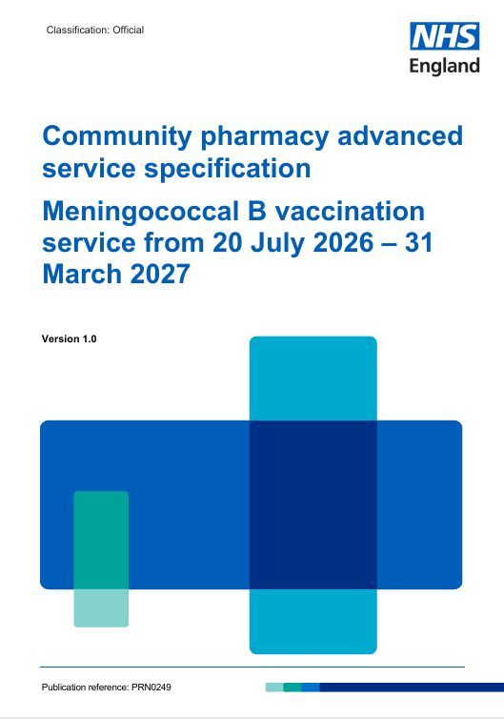
Service Specification
Service background
Commonly used terms
Aims and intended service outcomes
Requirements for service provision
  Service availability
Training and knowledge
Vaccine supply, handling and storage
Service specification
  Data collection and reporting requirements
Governance
Payment arrangements
Withdrawal from the service
Monitoring and post payment verification
Annex A
Notes:
34

Slide 35
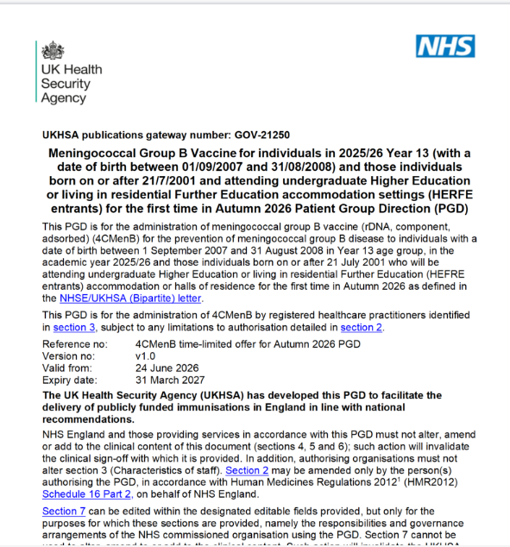
Patient Group Direction
Top tips
Always check you are using the latest version of the PGD
Do not administer the vaccine until all PGD declarations and authorisations have been completed
Be familiar with the inclusion and exclusion criteria before each vaccination
Keep signed PGD records secure and readily available for inspection
If you are unsure whether the PGD applies to a patient, seek advice before vaccinating
Notes:
35

Slide 36
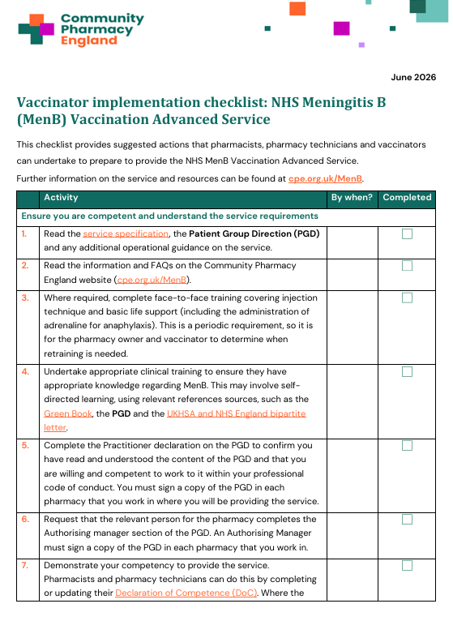
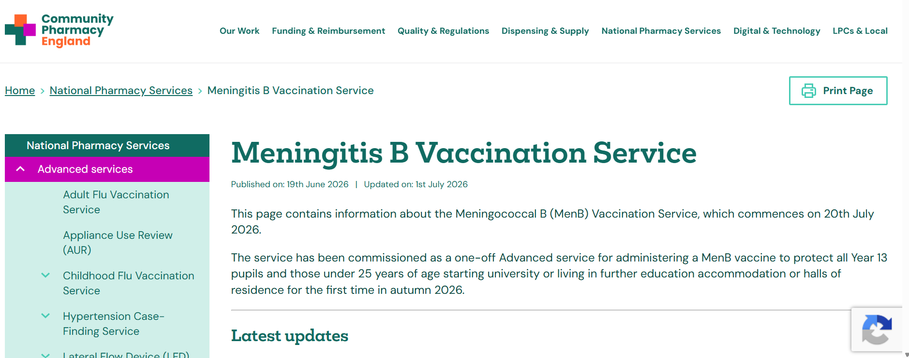
Community Pharmacy England
Key resources include:
Pharmacy owner implementation checklist for the NHS Meningococcal B Vaccination Service.
Vaccinator implementation checklist for the NHS Meningococcal B Vaccination Service
Pharmacy team briefing for the NHS Meningococcal B Vaccination Service
GP letter/email service notification template (Microsoft Word)
Briefing 011/26: Briefing for general practice teams: NHS Meningococcal B
Vaccination Service – Community Pharmacy England
Anaphylaxis action card .
Notes:
36

Slide 37
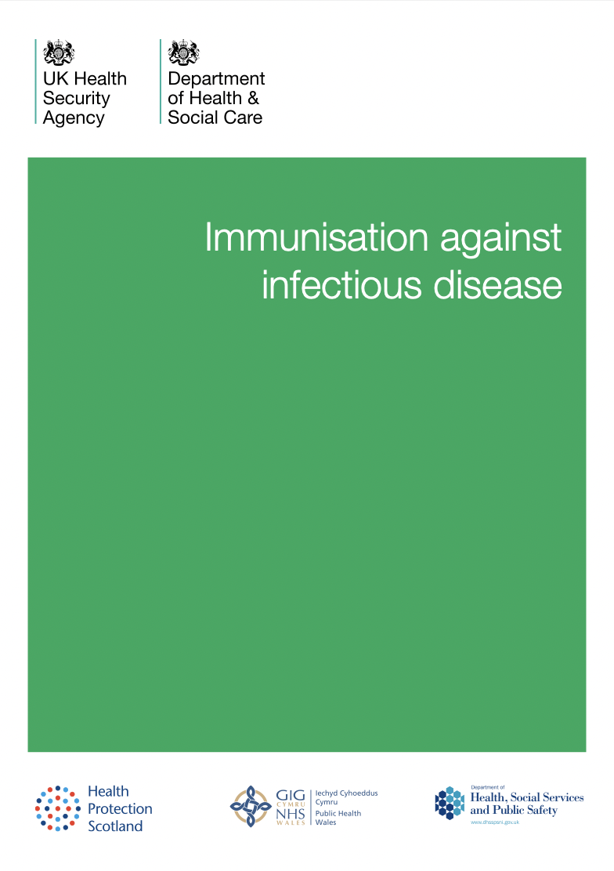
The Green Book
The Green Book – Immunisation Against Infectious Diseases
Notes:
37

Slide 38
Bexsero® – what you need to know

Slide 39
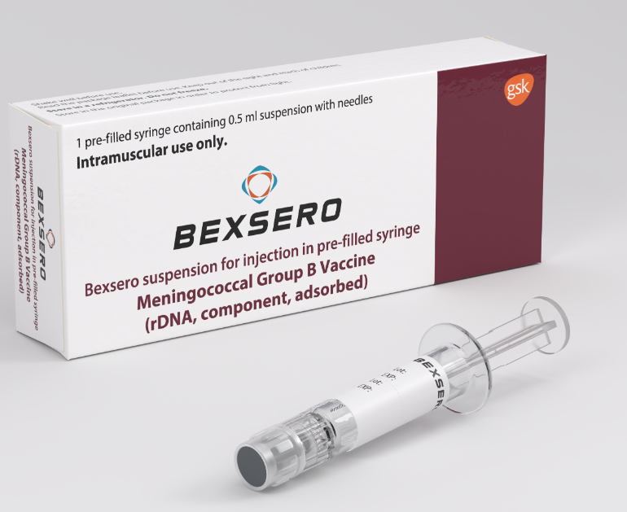
Bexsero® Meningococcal Group B Vaccine
Product overview, administration and dosing reminders
VACCINE PROFILE
Bexsero® is a multi-component inactivated vaccine marketed by GlaxoSmithKline
Licensed for use from two months of age
Supplied in packs of 10 (order using FDP) – 0.5ml volume
ADMINISTRATION
Administer by intramuscular injection (IM) into the deltoid muscle in the upper arm
Use the anterolateral thigh where the deltoid cannot be used
Adolescents and adults: 2 doses, a minimum of 4 weeks (28 days) apart
Use a 25mm 23G or 25G needle
(NOT supplied with vaccine)
Bexsero® Meningococcal Group B vaccine for injection in pre-filled syringe — Summary of Product Characteristics (SmPC)

Slide 40
Bexsero® presentation and preparation
BEFORE ADMINISTRATION
Check the presentation
Critical preparation point
Shake well to form a homogenous suspension; administer immediately.
1
Tip cap and rubber plunger stopper are made with synthetic rubber
2
Expect settling during storage
Fine off-white deposits may be noticeable in the syringe before preparation
STORAGE
3
IMPORTANT - Shake well
Keep in the original packaging between +2ºC and +8ºC
Form a homogenous suspension and administer immediately after preparation
Do not use if appearance varies
If there are signs of foreign particulate after shaking, do not administer.
4
Do not administer if the suspension is not homogenous or particulate matter is observed after shaking

Slide 41
Further information about Bexsero®
75%
NON-LIVE VACCINE
reduction in invasive MenB disease in those eligible for vaccination within 3 years
Made using recombinant vaccine technology and can be given:
At the same time as, or at any interval from, any other vaccines
Exception: Trumenba® should be given a minimum of 4 weeks apart
To pregnant or breastfeeding women when clinically indicated
To individuals with immunosuppression and human immunodeficiency virus (HIV)
ESTABLISHED USE
Routinely given to infants in the UK since 2015
Also used for adolescents and adults deemed to be at increased risk
Immunogenic in adolescents and adults
Notes:
because of underlying medical conditions or who are GBMSM and are at high risk of gonorrhoea infection

Slide 42
Bexsero® Contraindications
Few individuals are unable to receive meningococcal vaccines
DO NOT ADMINISTER TO THOSE WHO HAVE HAD
OR
A confirmed anaphylactic reaction to a previous dose of the vaccine
A confirmed anaphylactic reaction to any constituent, excipient or residue from the manufacturing process
There are very few individuals who cannot receive meningococcal vaccines.
When in doubt, seek advice rather than withhold immunisation.

Slide 43
Possible adverse reactions
Counselling points for adolescents and adults
MOST COMMON SIDE EFFECTS
ADVICE TO GIVE
In adolescents and adults:
Swelling, redness and tenderness at the injection site
Malaise, headache and nausea
Myalgia (muscle pain)
Arthralgia (joint pain)
Mild fever may occur, although high fever is uncommon
Routine prophylactic paracetamol is not recommended
Paracetamol or other over-the-counter pain relief may be taken if required to relieve symptoms
Side effects are common, usually mild, and typically resolve within 1–2 days
No increase in the frequency or severity of adverse reactions has been seen with subsequent doses of MenB vaccine.
Practical actions:
Prepare patients for expected short-term reactions and provide clear self-care advice
Remember to report any adverse reactions via the Yellow Card Scheme

Slide 44
Planning for a successful service

Slide 45
MenB vaccine supply: ordering actions
NHS England guidance on NHS Futures (login required) sets out how vaccine is allocated, ordered and delivered to pharmacies.
Read guidance
Allocation is earned through three readiness actions — but stock is drawn down only when an FDP order is actively placed.
Vaccine Supply and Ordering Guidance for Providers
1
2
3
Register by
20th July
2026
Register for service
MYA + FDP ready
Place FDP order
List 100 appointments/month on MYA and complete FDP site registration.
Sign up to provide MenB before the deadline.
Initial allocation is 10 doses.
All stock will need to be drawn down.
You must complete the prerequisites before placing vaccine orders.
Weekly:
Fixed weekly order deadline + delivery day for each pharmacy
Later allocations follow NBS bookings
Pharmacy still places an FDP order
Walk-ins:
Surplus stock only
There is no facility to order extra vaccine for walk-in demand
Need support? Contact NHS GM at england.gm.massvaccpmo@nhs.net

Slide 46
Appointment planning: July and September
Use the initial 10-dose allocation to set a realistic July offer, then pause posting September appointments until MYA updates are complete.
Do you need to review July appointments?
MYA update & second-dose booking
Urgently review first-week appointments already posted on MYA — ideally before tomorrow, when NBS opens for bookings.
Do not post appointments for 1st September 2026 to 31st January 2027 until after the platform update on 6th August
10
doses
initial stock allocation
12
service days
in July
6th
7th
2nd
6th Aug
7th Aug
2nd dose
NHS England does not expect 100 July NBS appointments during the 12 operating days. Align July slots to the initial allocation and your delivery timing.
MYA platform updates
Resume posting Sept–Jan slots
Encourage booking after first dose
Operational implication: patients vaccinated in early August may need to wait until September slots are added from 7 August before booking their second appointment.
Stock watch: in the first weeks, monitor available vaccine against NBS bookings and close un-booked slots to ensure you do not have more bookings than vaccine available.
Need support? Contact NHS GM at england.gm.massvaccpmo@nhs.net

Slide 47
What is RAVS?
Record a Vaccination Service
WHEN ADMINISTERING A VACCINE
Recording checklist
RAVS is the NHS England national vaccination recording system, developed to replace older point-of-care systems for many vaccination programmes.
Pharmacists use RAVS to capture the core vaccination record.
MenB service
1
Identify the patient
The only recording platform available for the MenB Service
Using NHS number or demographics.
2
Record vaccination details
Important limitation
Vaccine, batch number, site, vaccinator and consent.
RAVS does not provide a risk assessment or patient consultation pathway in the same way as platforms such as PharmOutcomes.

Slide 48
Planning your Men B Service
AIM TO
1
2
3
Start of service
At least 28 days later
Before 2026/27 academic year
Offer the first dose as soon as possible after the service starts
Administer the second dose at least 28 days later
Wherever possible, complete both doses before the start of the academic year
REMEMBER
This allows sufficient time for the second dose to be completed before the service end date
Plan clinics around vaccine supply and expected demand
31 December 2026
The first dose must be given by this date
Build clinic capacity around both dose timing and expected demand.

Slide 49
Off-site MenB clinics: key takeaways
For training: what must be confirmed before delivering vaccinations away from the pharmacy.
1
Get approval before planning the clinic
Training message
Written approval from the NHS England Regional Vaccinations Team is required before any off-site vaccinations are provided.
No approval, no clinic.
The venue and clinical lead must be confirmed before patients are booked.
2
Use only approved, suitable venues
Campuses, colleges, community centres or other venues must support privacy, confidentiality, dignity and a safe clinical environment.
3
Name the on-site clinical lead
A pharmacist or pharmacy technician must be on site, responsible for delivery, specification compliance and clinical oversight throughout the session.
Think: approval, venue, oversight.

Slide 50
Off-site clinic readiness checklist
Use this as the practical “before you leave the pharmacy” checklist for every off-site session.
People and supervision
Cold chain and vaccine security
Clinical lead on site throughout the session.
Support staff considered for emergencies, admin and chaperoning.
Indemnity covers the activity, all staff involved and the venue.
Transport in a validated cool box at 2–8°C.
Keep vaccines in original packaging and insulated from ice packs.
Monitor and document temperatures throughout transport.
Waste and clinical standards
Risk, records and contingency
Dispose safely of sharps, PPE and clinical waste.
Comply with waste transfer legislation if returning waste to pharmacy.
Continue to meet all GPhC professional standards.
Complete a documented risk assessment before each clinic.
Confirm IPC, emergency procedures, patient safety and consent processes.
Plan for recording, data protection, accessibility and incident reporting.
Final check: confirm patient flow, waiting area, accessibility, vaccine and record security, lone working, host communication and incident reporting before the session starts.
Notes:
Too much info

Slide 51
Private Service — MenB
Private vaccination route supporting community protection outside NHS eligibility.
VACCINE OPTION
Service essentials
Trumenba
Protects people outside NHS eligibility
2
MenB
subgroups
covered
10+
years
and above
Supports wider community protection through a private service offer.
Private PGD required
Ensure the private PGD is in place before supply and administration.
Operational notes
Do not use NHS vaccines
Stock — Singles
Keep private stock and NHS-funded stock clearly separated.
Stock — Alliance
Bexsero or Trumenba available
Rebate available
Choose the appropriate MenB vaccine according to service requirements.

Slide 52
Funding

Slide 53
Funding
Per MenB vaccine administered
Payment | Condition | Amount
Service set-up payment | After first vaccination | £300
Activity payment | 100+ vaccinations by 31 March 2027 | £400
Maximum additional funding available |  | £700
Key points
Centrally supplied vaccine stock
£10.06
Vaccine stock is centrally supplied; no separate reimbursement claim is required for vaccine costs.
No reimbursement claim for vaccine costs
Funding comes from the NHS vaccination budget, not the CPCF contract sum
Providers are required to administer a minimum of 10 vaccines between 20th July and 30th September 2026 or the commissioner may suspend the supply of vaccine

Slide 54
Claiming payment via MYS
1
2
3
4
Submit manually
Deadline
Claim window
Late claims
via MYS
by the 5th of the following month
up to 3 months after the claim period
will not be paid
Submit on time: late claims will not be paid

Slide 55
Summary

Slide 56
Key dates
20th July
Register to provide the service – check confirmation received
31st December 2026
Last date to give the first vaccine
1
2
3
4
July and August
Ideal window for first and second doses before university starts
Minimum 4 weeks between doses
31st March 2027
Service ends and final date for eligible patients to receive their second dose
Key message: Encourage eligible patients to receive their first dose as early as possible in the summer to ensure full protection before starting university.

Slide 57
Service summary
Why it matters
Target group
Pharmacy role
Safety net
MenB disease is rare but can be life-threatening
Year 13
Community pharmacies play a key role in:
After vaccination patients should remain aware of meningococcal symptoms and seek advice if unwell or concerned
Presents as meningitis, septicaemia or both
students and first-time higher/further education entrants at increased risk
Improving access to vaccination
Helps protect against most, but not all, MenB bacteria
Early recognition and urgent treatment is essential
Two doses of Bexsero®, given at least 4 weeks apart, are required for full protection
Increasing uptake
Protecting patients before they enter higher or further education
The vaccine does not protect against all causes of meningitis or septicaemia
Both doses should preferably be offered before the start of the 2026/2027 academic year
Notes:
Also provides evidence to NHS Community pharmacy can increase uptake of vaccines and be part of further national immunisation schedules eg pertussis, childhood imms, pneumonia, shingles and RSV

Slide 58
Top tips for success
1
Know the eligibility criteria
5
Explain side effects and safety-net appropriately
2
Promote the service - every eligible patient is an opportunity
6
Book the second dose before the patient leaves
3
Check vaccination history carefully
7
Record accurately
4
Follow the PGD and clinical guidance every time
8
Submit MYS claims on time
Every eligible patient is an opportunity — make the vaccination, second dose and claim process easy to complete. Non Eligible provide private service

Slide 59
Next Steps

Slide 60
Next steps: the 4 Ps
Use each phase to check service readiness before launch and during early delivery
01
02
03
04
Plan
Prepare
Promote
Provide
Set up NBS and central ordering
Check consultation room set up
Review patient journey
Complete all training and record
Read and sign the PGD
Read service spec and CPE guidance
Develop SOPs / risk assessment
Complete Vaccinator / Pharmacy Contactor checklist
Team briefings
GP engagement
Contact colleges & universities
Patient awareness — promote the service
Deliver vaccinations safely
Book second doses
Record activity
Claim payment

Slide 61
Any Questions ?

